Slide 1
Lecture 8 3D Modeling and Animation Assoc.Prof.Dr. Hossam Mahmoud Moftah Associate professor – Faculty of computers and artificial intelligence– Beni-Suef University

Slide 2
Chapter 5 Understanding Modeling and
Texturing
Adapted from Andy Beane: 3D animation essentials 2012 by John Wiley & Sons, Inc.,

Slide 3
Modeling
Subdivision Surfaces
Subdivision surfaces (or subDs) are a form of geometry that seems to combine the ease of polygons with the rounded, smoothed shapes of NURBS.
Figure 5.26 shows the creation of a subdivision surface.
We start with the cube polygon on the left.
That cube is then subdivided three times to create the sphere in the middle.
The sphere on the right is the result of the cube being converted into a subdivision surface.
Adapted from Andy Beane: 3D animation essentials 2012 by John Wiley & Sons, Inc.,

Slide 4
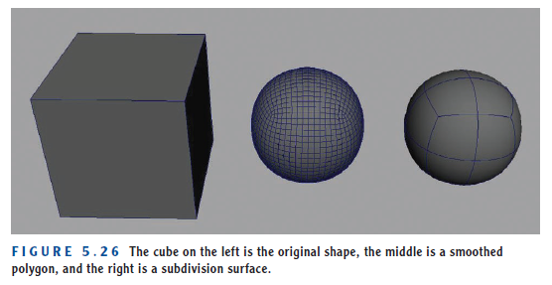
Modeling
Subdivision Surfaces
Subdivision Surfaces
Adapted from Andy Beane: 3D animation essentials 2012 by John Wiley & Sons, Inc.,

Slide 5
Modeling
Modeling Workflows
Types of workflows:
From-Scratch Modeling
Primitive Modeling
Box Modeling
Boolean Modeling
Laser Scanning
Digital Sculpting
Adapted from Andy Beane: 3D animation essentials 2012 by John Wiley & Sons, Inc.,

Slide 6
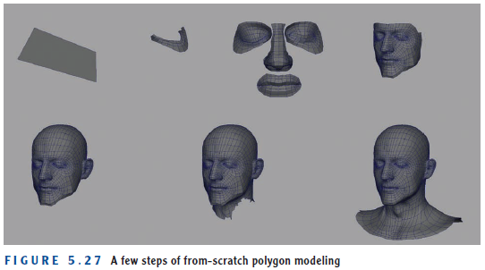
Modeling
Types of workflows:
From-Scratch Modeling
In from-scratch modeling, you lay out each vertex and draw each polygon one by one until the entire model is completed (see Figure 5.27).
This technique is not popular today because of advancements in polygon modeling and editing tools in most 3D applications.
Adapted from Andy Beane: 3D animation essentials 2012 by John Wiley & Sons, Inc.,

Slide 7
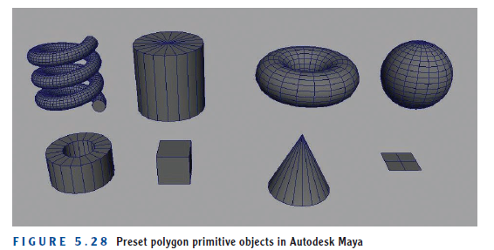
Modeling
Types of workflows:
2. Primitive Modeling
In primitive modeling, you start with basic shapes given to you by the software—for instance, helix, cylinder, torus, sphere, pipe, cube, cone, or plane, as shown in Figure 5.28.
You then have to make only minor changes to the primitive model to create an object.
This type of modeling is great for hard-surface models such as tables, chairs, pencils, picture frames, simple buildings, and swords.
Adapted from Andy Beane: 3D animation essentials 2012 by John Wiley & Sons, Inc.,

Slide 8
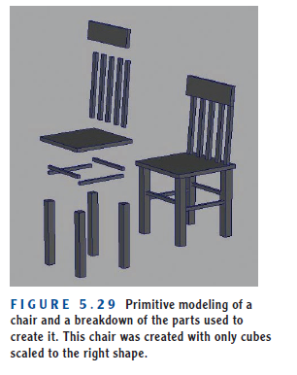
Modeling
Types of workflows:
2. Primitive Modeling
Adapted from Andy Beane: 3D animation essentials 2012 by John Wiley & Sons, Inc.,

Slide 9
Modeling
Types of workflows:
3. Box Modeling
Box modeling is a popular approach to character modeling and can allow for a quick creation of basic shapes.
In this approach, you start with a cube and extrude arms, fingers, legs, toes, and a head.
You then add detail to the whole shape by splitting and refining the model. Figure 5.30 shows a few of the steps used to create a character.
Adapted from Andy Beane: 3D animation essentials 2012 by John Wiley & Sons, Inc.,

Slide 10
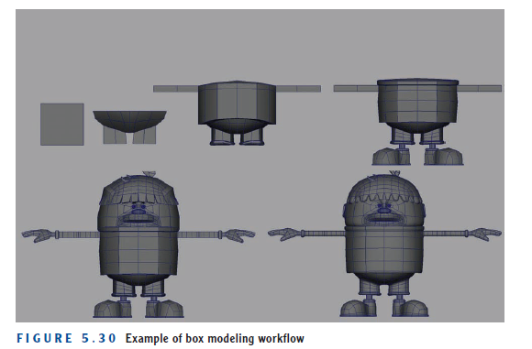
Modeling
Types of workflows:
3. Box Modeling
Adapted from Andy Beane: 3D animation essentials 2012 by John Wiley & Sons, Inc.,

Slide 11
Modeling
Types of workflows:
4. Boolean Modeling
Boolean modeling is an additive or subtractive method of changing the geometry of one object by introducing another object and running a Boolean function.
The Boolean function takes the two objects and makes them a new, single object, either by cutting one object out of the other, or combining the two objects to create one, or using the negative space of the intersection as the new object.
Adapted from Andy Beane: 3D animation essentials 2012 by John Wiley & Sons, Inc.,

Slide 12
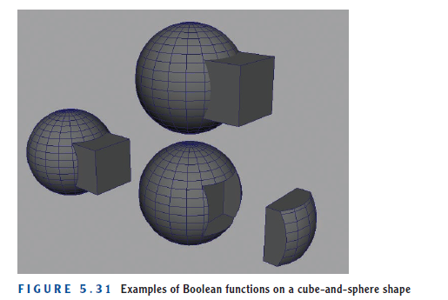
Modeling
Types of workflows:
4. Boolean Modeling
Adapted from Andy Beane: 3D animation essentials 2012 by John Wiley & Sons, Inc.,

Slide 13
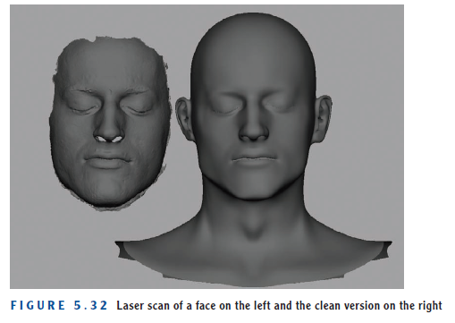
Modeling
Types of workflows:
5. Laser Scanning
Laser scanning is a new type of modeling that starts with a real object that you digitally laser-scan to create the geometric surfaces.
Figure 5.32 shows a face that was scanned on the left and the cleaned-up head on the right.
Adapted from Andy Beane: 3D animation essentials 2012 by John Wiley & Sons, Inc.,

Slide 14
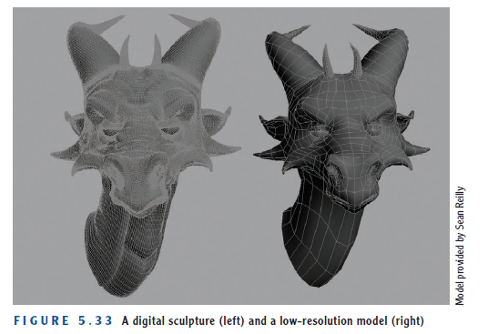
Modeling
Types of workflows:
6. Digital Sculpting
Digital sculpting is a rather new modeling workflow that enables artists to use a massive polygon resolution to create a surface that can be pushed and pulled like clay.
Sculpting
Adapted from Andy Beane: 3D animation essentials 2012 by John Wiley & Sons, Inc.,

Slide 15
Texturing
Texturing is the process of creating the surfaces and color attributes of models to make them resemble whatever object they are supposed to represent.
A person who textures models is called a texture artist.
However, at some studios, the modeler is responsible for texturing models.
Adapted from Andy Beane: 3D animation essentials 2012 by John Wiley & Sons, Inc.,

Slide 16
Texturing
Typically, texture artists receive a final model from the modeling department and have to create a UV map for the object(s).
They then create the shader with the correct surface properties to represent the object(s).
Next they hand-paint or photo-manipulate images in software such as Adobe Photoshop or Autodesk Mudbox to create texture maps for the different properties of the shader, such as a color map or reflectivity map.
Texture artists also create renderings of the object to show the lighting team what the object should look like after it is lit and rendered.
Adapted from Andy Beane: 3D animation essentials 2012 by John Wiley & Sons, Inc.,

Slide 17
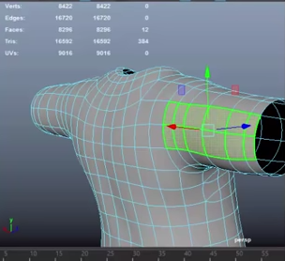
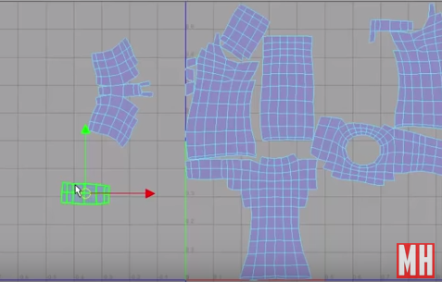
Texturing
Uvs
UVs are 2D representations of a 3D object.
Example of a 3D model with the UV map
Adapted from Mike Hermes YouTube channel
Adapted from Andy Beane: 3D animation essentials 2012 by John Wiley & Sons, Inc.,

Slide 18
Texturing
The 3D software can create new UVs on an object through a series of automated functions (illustrated in Figure 5.35.) such as :
planar,
cylindrical,
spherical,
automatic mapping,
These functions “unwrap” the object and attempt to lay out the UVs on a 2D plane.
The planar, cylindrical, and spherical function types project the UV coordinates from a plane, cylinder, or sphere, respectively, onto the object, collect the data, and make the 2D map.
Adapted from Andy Beane: 3D animation essentials 2012 by John Wiley & Sons, Inc.,

Slide 19
Texturing
This type of projection works great on models that are spheres, cylinders, and planes, but on more-complex models such as a human form, these techniques are not enough.
Automatic mapping can get you a little further in the process because it projects from a user-defined number of planes, whereas the other mapping types use only one projection to help break down the process into smaller data pieces.
Adapted from Andy Beane: 3D animation essentials 2012 by John Wiley & Sons, Inc.,

Slide 20
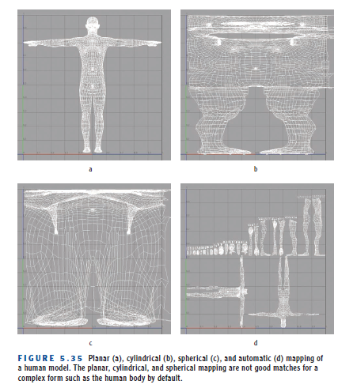
Texturing
Adapted from Andy Beane: 3D animation essentials 2012 by John Wiley & Sons, Inc.,

Slide 21
Texturing
The 3D artist starts with one of the four UV projection types covered already.
Then the artist separates, moves, scales, and reattaches the UVs to create a UV map that is uniform and laid out in a way that will make texture painting easy.
Adapted from Andy Beane: 3D animation essentials 2012 by John Wiley & Sons, Inc.,

Slide 22
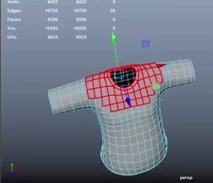
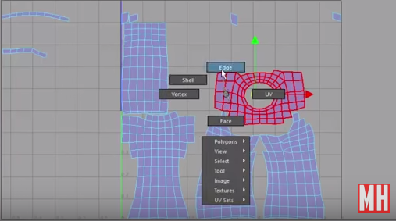
Texturing
The artist separates, moves, scales, and reattaches the UVs to create a UV map
Example1:
Adapted from Mike Hermes YouTube channel
Adapted from Andy Beane: 3D animation essentials 2012 by John Wiley & Sons, Inc.,

Slide 23
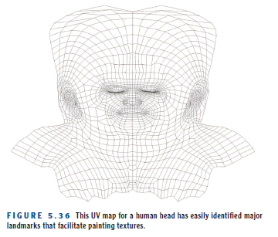
Texturing
The artist separates, moves, scales, and reattaches the UVs to create a UV map
Example2:
Adapted from Andy Beane: 3D animation essentials 2012 by John Wiley & Sons, Inc.,

Slide 24
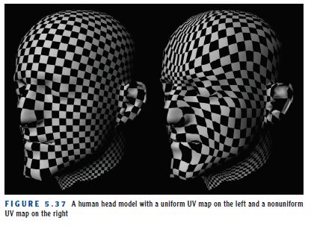
Texturing
This mapping process must take into account uniform spacing of the UVs to help ensure an even distribution of the texture.
The UV process often applies a texture with a checkered pattern to the model to verify that the surface has uniformly spaced UVs.
Adapted from Andy Beane: 3D animation essentials 2012 by John Wiley & Sons, Inc.,

Slide 25
Texturing
UVs are output to an image file called a UV map that is used in image manipulation software such as Adobe Photoshop as the artist’s roadmap of the UV space for a specific object.
This UV map enables the artist to paint the textures of an object and know where he or she is painting on the 3D object.
Adapted from Andy Beane: 3D animation essentials 2012 by John Wiley & Sons, Inc.,

Slide 26
Texturing
Shaders:
Shaders are the instructions that the software uses to calculate rendering effects, and they allow an artist to define the look of the object and the way its surface behaves in the final render.
After the UVs are laid out, the texture artist assigns the shader (also called a material or surface) to the model.
Adapted from Andy Beane: 3D animation essentials 2012 by John Wiley & Sons, Inc.,

Slide 27
Texturing
Shaders:
The following are the basic shader attributes:
Color
Ambience
Transparency
Reflectivity
Refraction
Translucency
Incandescence
Specular highlights
Glow
Bump
Adapted from Andy Beane: 3D animation essentials 2012 by John Wiley & Sons, Inc.,

Slide 28
Texturing
Shader attributes:
Color
Color is the color of the object, such as red or blue. This can be a flat color or a texture map.
Ambience
Ambience in the surface property is a simulation of even flat lighting coming from every direction onto the surface (this is not from an actual light source). Figure 5.38 shows an example.
Adapted from Andy Beane: 3D animation essentials 2012 by John Wiley & Sons, Inc.,

Slide 29
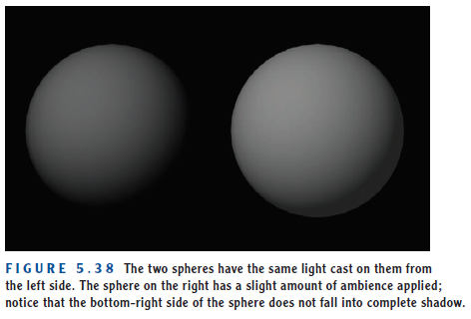
Texturing
Shader attributes:
Ambience
Adapted from Andy Beane: 3D animation essentials 2012 by John Wiley & Sons, Inc.,

Slide 30
Texturing
Shader attributes:
Transparency
Transparency is how transparent or see-through the object will be. This attribute is used to create effects such as glass.
Reflectivity
Reflectivity is how reflective the object will be.
Refraction
Refraction is the change in light direction caused by a change in speed that occurs as light passes through a solid, transparent object.
for example, when you look through a glass of water and see an object behind the glass appear distorted.
Adapted from Andy Beane: 3D animation essentials 2012 by John Wiley & Sons, Inc.,

Slide 31
Texturing
Shader attributes:
Translucency
Translucency is the amount of light that can pass through an opaque object such as paper or canvas.
Incandescence
Incandescence is the quality of self-illumination—for example, a computer monitor that is emitting light or a lamp shade with the light on.
Specular highlights
Specular highlights are bright spots that appear on an object’s surface when light shines on that object.
Adapted from Andy Beane: 3D animation essentials 2012 by John Wiley & Sons, Inc.,

Slide 32
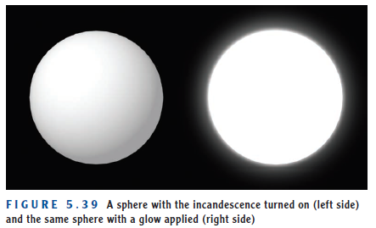
Texturing
Shader attributes:
Glow
Glow is a standard attribute that most 3D applications can simulate to aid in the effect of self-illumination.
Figure 5.39 shows an example. The object on the left is bright, like a self-illuminated object, with no halo glow around.
The object on the right has the addition of glow, which makes the effect look more realistic.
Adapted from Andy Beane: 3D animation essentials 2012 by John Wiley & Sons, Inc.,

Slide 33
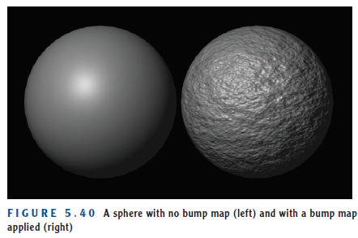
Texturing
Shader attributes:
Bump
Bump simulates a texture along the surface of an object by adding shadow and highlight effects along the surface.
Bump maps are grayscale images in which a mid-gray color represents no change in the surface, black represents inward changes to the surface, and white represents a push outward in the surface.
Adapted from Andy Beane: 3D animation essentials 2012 by John Wiley & Sons, Inc.,

Slide 34
Texturing
Shaders:
The shader types:
Flat
Lambert
Blinn
Phong
Cook-Torrance
Subsurface scattering
Car paint
Physical architecture
Adapted from Andy Beane: 3D animation essentials 2012 by John Wiley & Sons, Inc.,

Slide 35
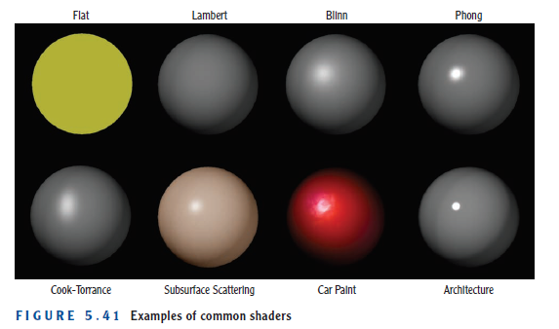
Texturing
Shaders:
The shader types:
Adapted from Andy Beane: 3D animation essentials 2012 by John Wiley & Sons, Inc.,

Slide 36
Texturing
Shaders:
The shader types:
Flat
Flat shaders, one of the most basic types used today, always return a flat 2D color even on a 3D object.
Lambert
Lambert shaders provide the most basic illumination.
These 3D shaders use color but have no options for specular highlights or reflections.
Blinn
Blinn shaders allow for specular highlights and reflections.
Adapted from Andy Beane: 3D animation essentials 2012 by John Wiley & Sons, Inc.,

Slide 37
Texturing
Shaders:
The shader types:
Phong shaders
Phong shaders create a shiny look by adding a sharp specular highlight.
This type of shader is good for plastics and other shiny objects.
Cook-Torrance
Cook-Torrance shaders mimic the specular highlights of surfaces with microfacets in them, such as brushed metals.
These highlights spread along the surface of an object instead of creating a pure reflection.
Cook-Torrance
Adapted from Andy Beane: 3D animation essentials 2012 by John Wiley & Sons, Inc.,

Slide 38
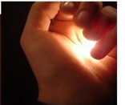
Texturing
Shaders:
The shader types:
Subsurface scattering shaders
Subsurface scattering shaders take into account light penetrating the surface of an object, scattering within the object, and then passing back out of the object.
Human skin, milk, and marble are a few examples that can be created with subsurface scattering.
See the fingers
Adapted from Andy Beane: 3D animation essentials 2012 by John Wiley & Sons, Inc.,

Slide 39
Texturing
Shaders:
The shader types:
Car paint shaders
Car paint shaders take into account the complex nature of car paint, which is composed of two or more surfaces interacting with one another.
Physical architecture shaders
Physical architecture shaders are physically accurate and simulate real-world illumination properties to re-create many object types: metal (shiny and brushed), glass, plastics, ceramics, and water.
Adapted from Andy Beane: 3D animation essentials 2012 by John Wiley & Sons, Inc.,

Slide 40
The End

